Slide 1
CREATED BY SHAILU

Slide 2
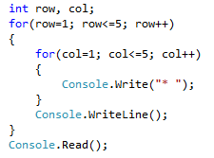

Different Types Patterns

Slide 3
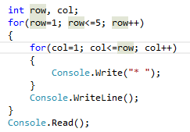

Pattern Types 2

Slide 4
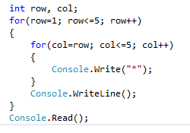

Pattern Type 3

Slide 5
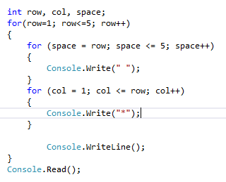
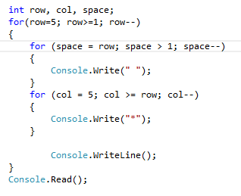

Pattern Rule 1 & 2

Slide 6
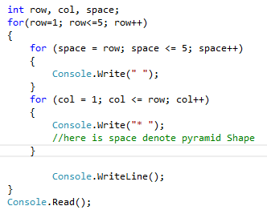

4.

